Slide 1

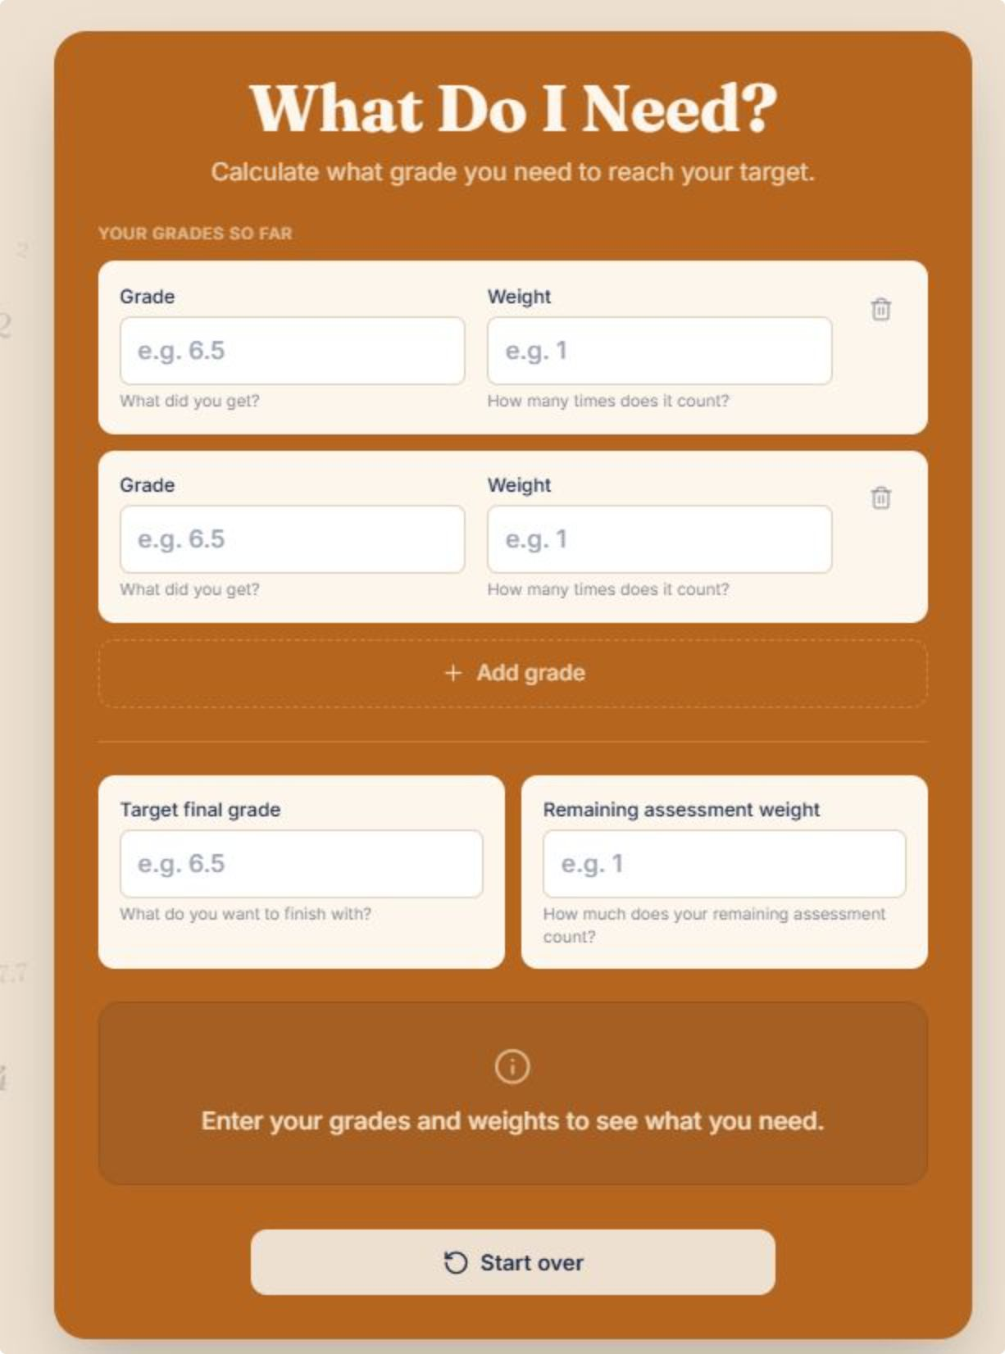
Grade Calculator
A web app that helps students understand and manage academic performance
BART BRUGGELING & AMIEN EL AZZOUZI

Slide 2
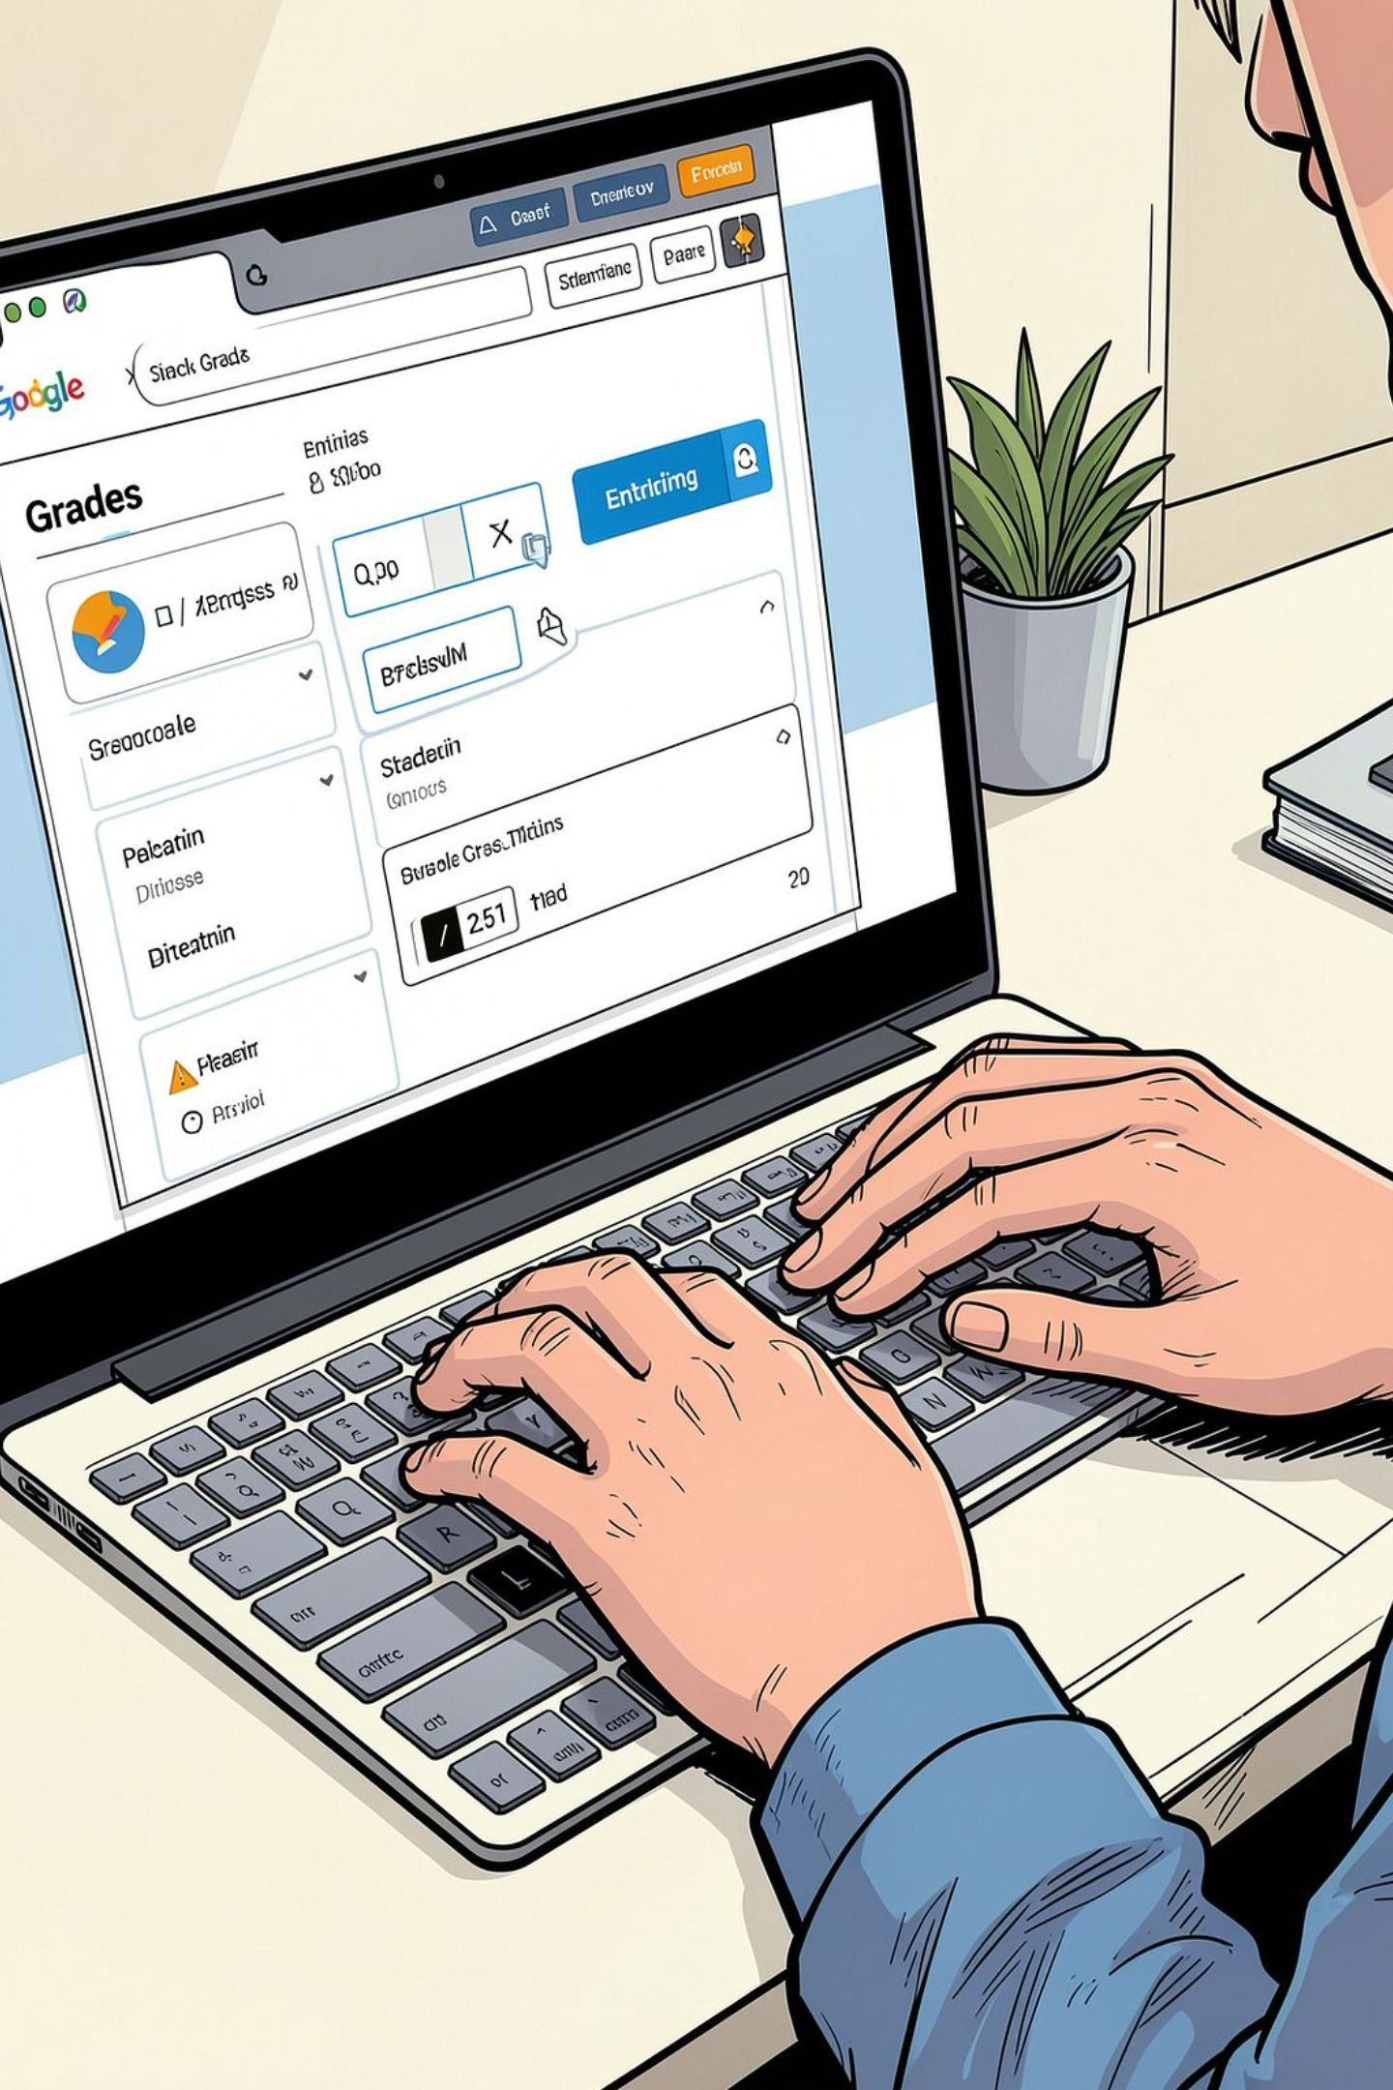
What It Does
Enter Grades
Calculate Average
Input obtained grades and weights
Current average shown automatically
Plan Ahead
See what grade you need to reach your target

Slide 3


Who It's For & SDG 4
Target Users
Secondary & higher education students
SDG 4: Quality Education
Helps students take control of learning and make informed decisions
How to Run
No installation — open the link, enter grades & weights, get instant results

Slide 4

Ethical Reflection
Access Barriers
Unintended Use
Future Improvements
Requires device, internet & digital skills
Risk of stress or grade-fixation over learning
Multiple grading systems, languages & accessibility
A planning tool — not a replacement for learning

